Slide 1

Be The Wall
A Practical Social Marketing Campaign to Prevent
Underage Drinking

Slide 2
Purpose and Objectives
To provide a basic, ‘Social Marketing 101’ introduction; for some participants this will be a ‘first time primer’ and for others, a refresher.
To provide a thorough understanding of Be the Wall Implementation Strategies
To provide a thorough understanding of all that the Be the Wall campaign offers
    Tools/Products
    Materials
    Interactive Website
    Training
To answer your questions

Slide 3
Part 1. Social Marketing 101
Social Marketing IS
Selling a behavior, as opposed to a product, for the good of the community
Provides consumers with facts and then asks them to make a conscious choice to participate in, or change, a behavior
Is a ‘stay the course’ process – It produces a ‘slow but steady’, lasting change

Slide 4
Social Marketing is NOT. . .
Not about our Organizations
Not about Blame

Slide 5


Slide 6
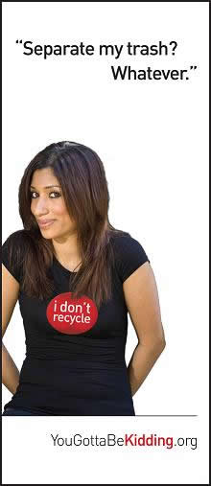
Social Marketing is NOT. . .
Not about Insulting

Slide 7
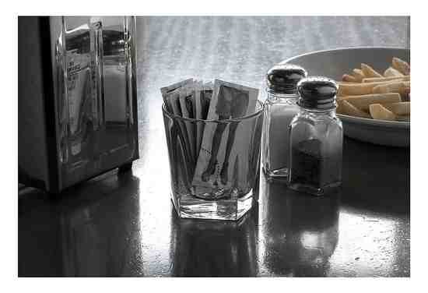
Social Marketing is NOT
Not about Scare Tactics

Slide 8
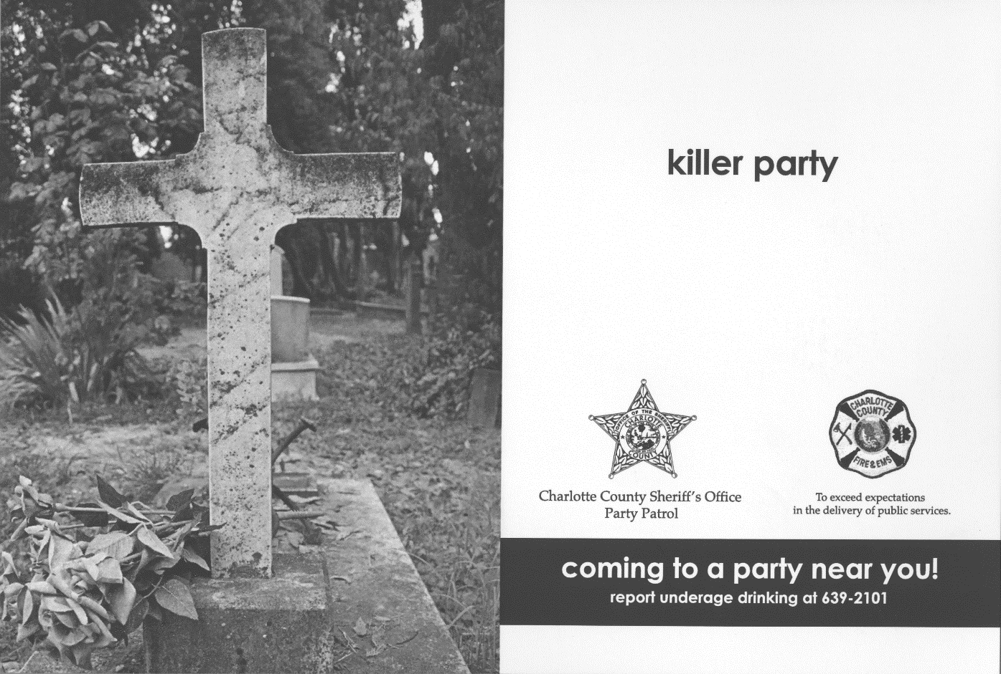
Social Marketing is NOT
Not about Scare Tactics

Slide 9
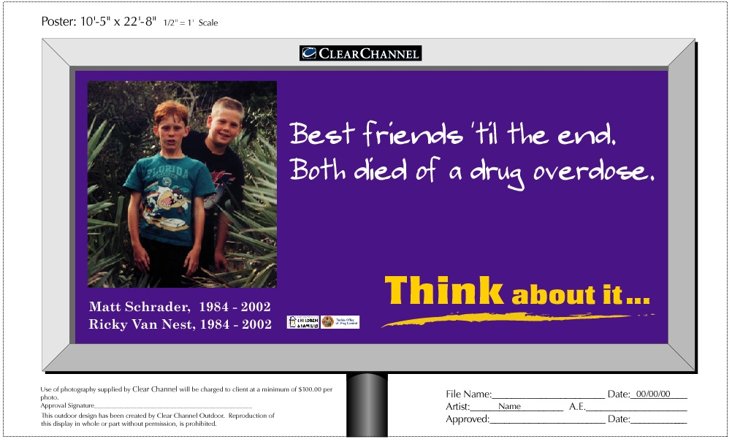
Social Marketing is NOT
Not about Scare Tactics

Slide 10

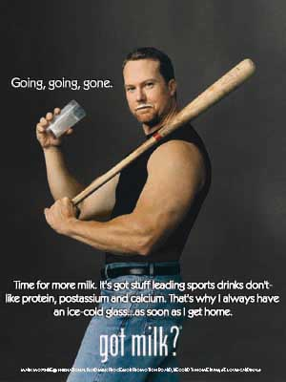
Social Marketing is NOT
Not about Promotion or Media Outreach only

Slide 11
Social Marketing IS. . .
Accepting a NEW Behavior
Rejecting a POTENTIAL Behavior
Modifying a CURRENT Behavior
Abandoning an OLD Behavior

Slide 12

Social Marketing IS. . .

Slide 13
Social Marketing Process
Be the Wall Campaign – Design appropriate strategy of manipulating the Five “P’s”
of Social Marketing:
      Product (Service)
      Price
      Place
      Promotion
      Politics

Slide 14
Part 2. Be The Wall Implementation Strategies
Behaviors
  Social Marketing, and the Be The Wall campaign is using commercial marketing practices to market principles – we’re asking for abstract behavior change
  Traditional Prevention Practices:
    A table at a venue is probably not going to get the level of a behavior change
  We use multiple ways to deliver our message:
    “Be the Wall between teens and alcohol”

Slide 15
Be the Wall – The Launch
How will you Launch the campaign?
  Two Different Techniques – both valid
  Note: Once you do launch – ‘STAY the COURSE’. Don’t ‘stop and start’; be consistent
Who will be your target first?
Where will it be?

Slide 16
Be The Wall –
Traditional Approaches
Information tables
Presentations
Poster drops

Slide 17
Be The Wall –
Other Approaches
Branding
T-Shirt walks/trees
Conversation challenges
Text trees
Email trees
Parent Pick-Up at schools
Guerilla marketing

Slide 19
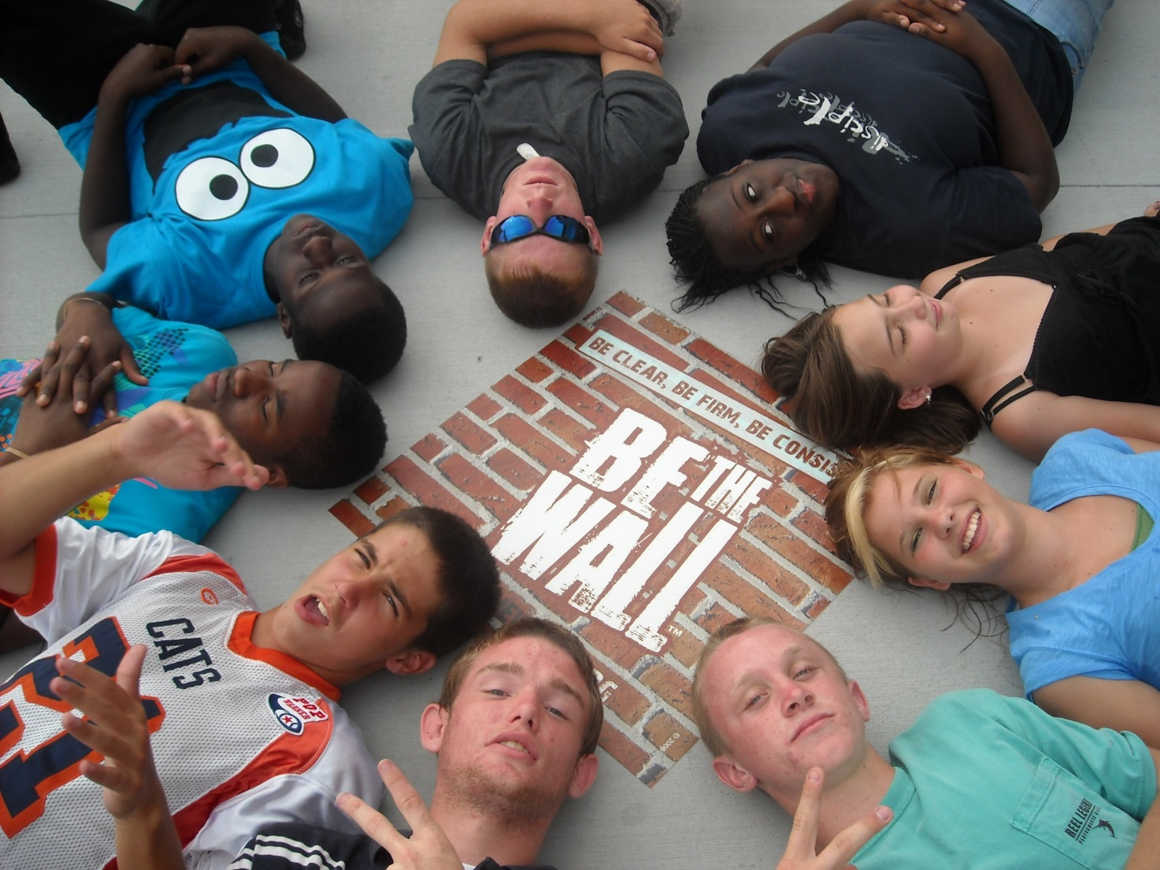

Slide 20


Slide 21
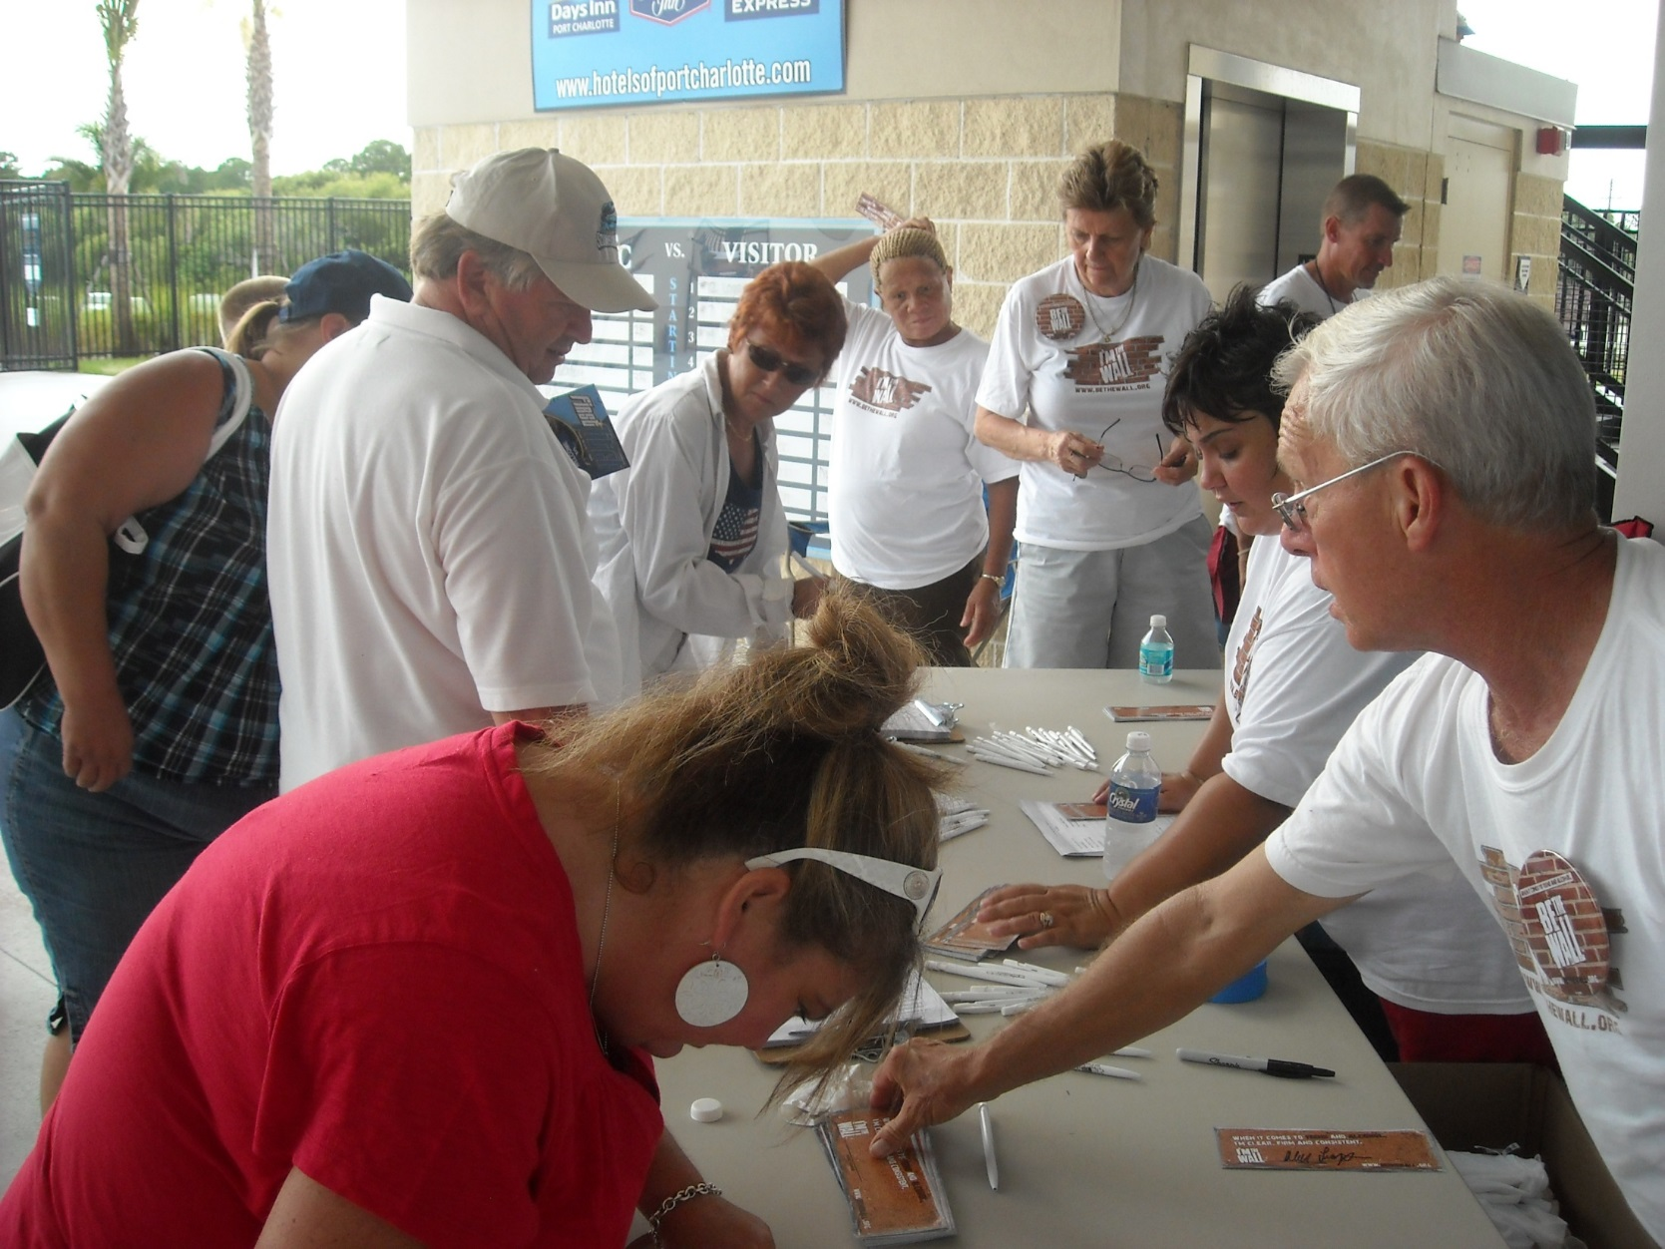

Slide 22
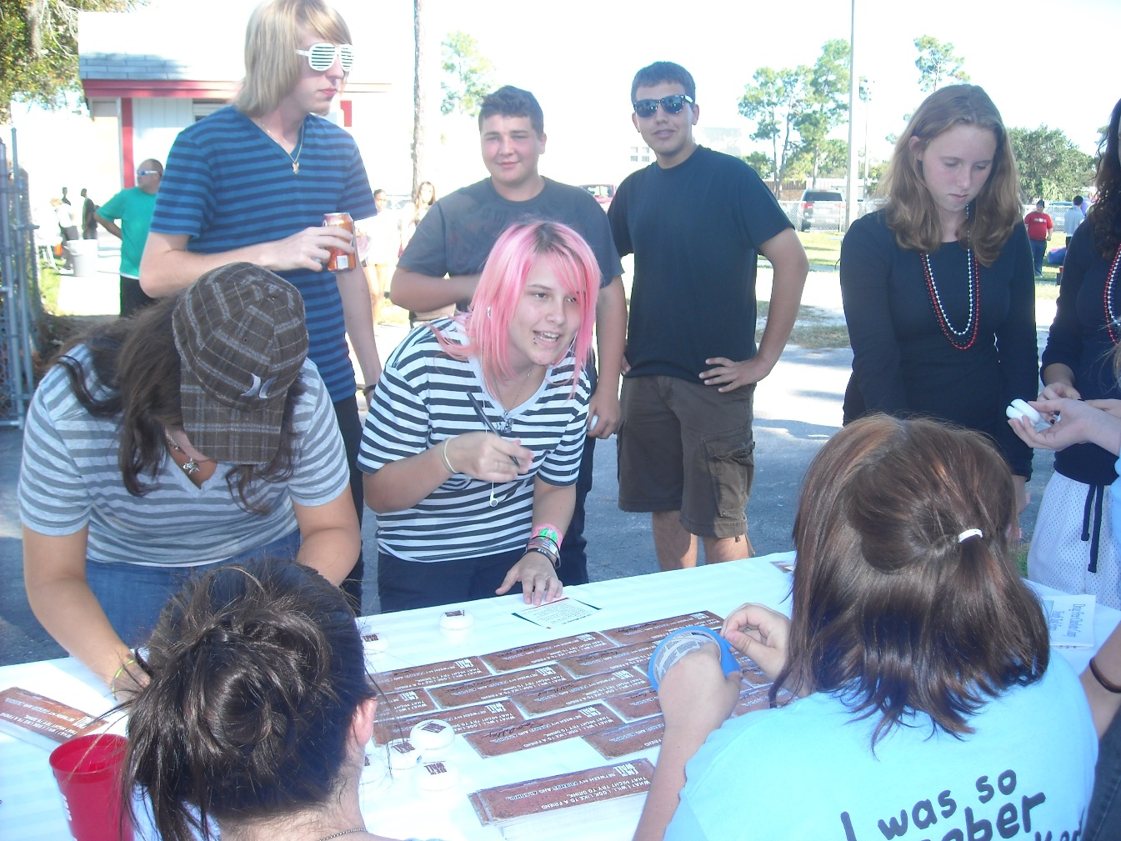
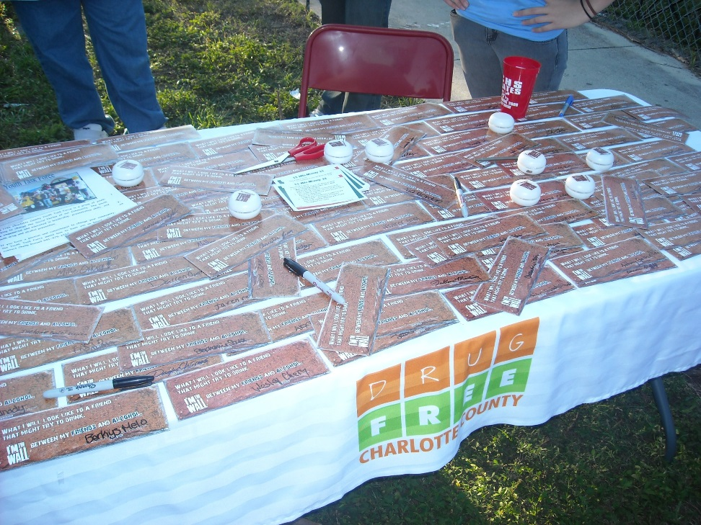

Slide 23
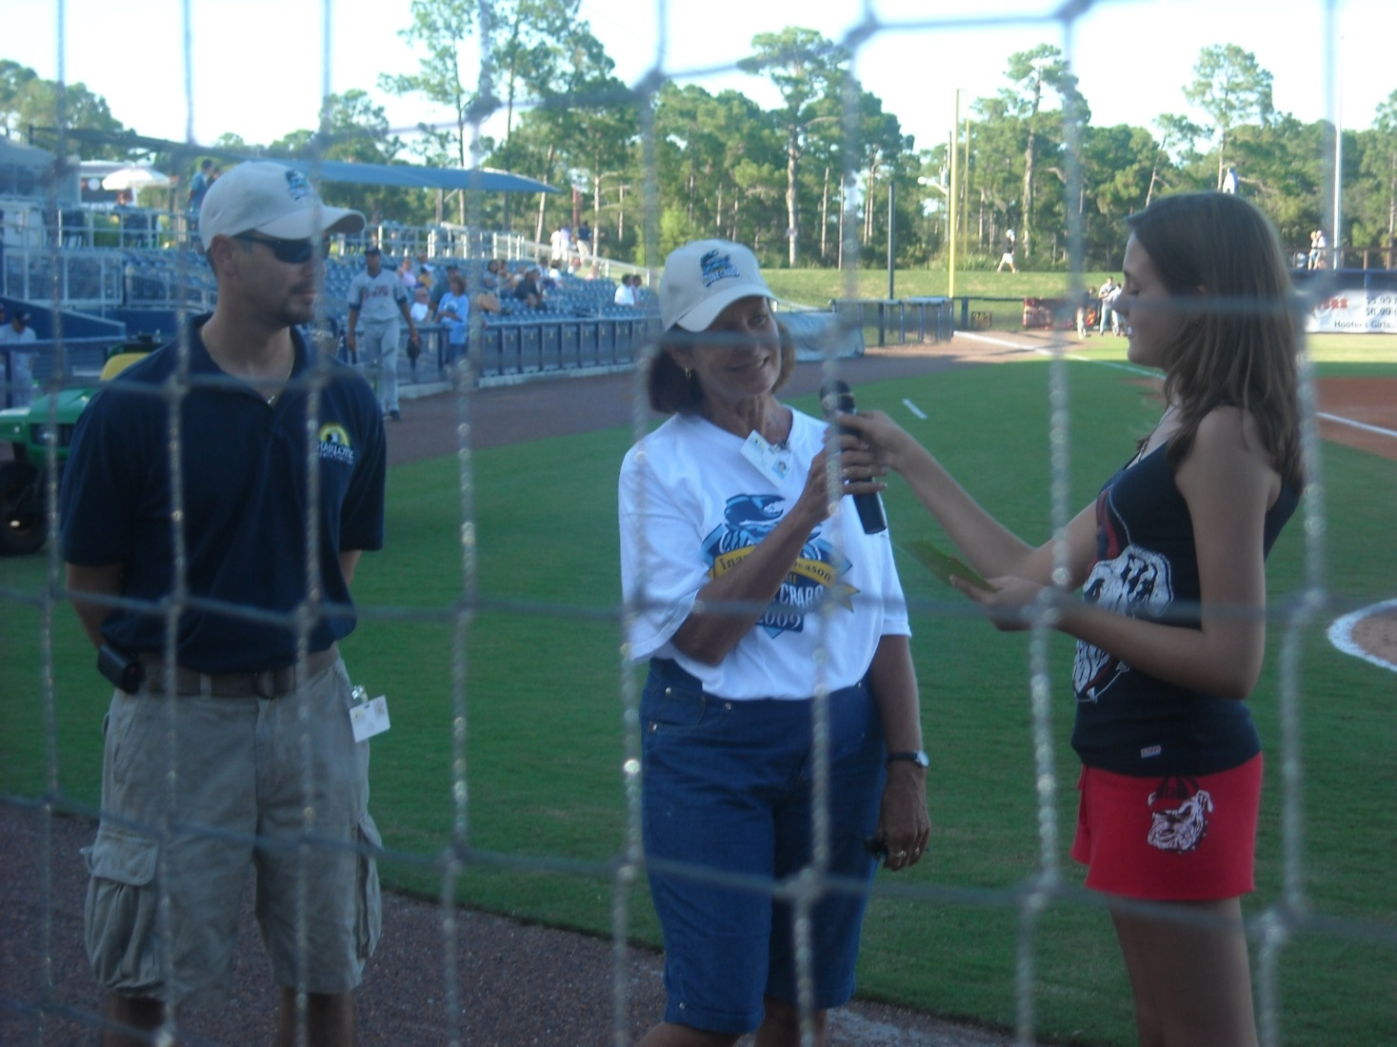

Slide 24
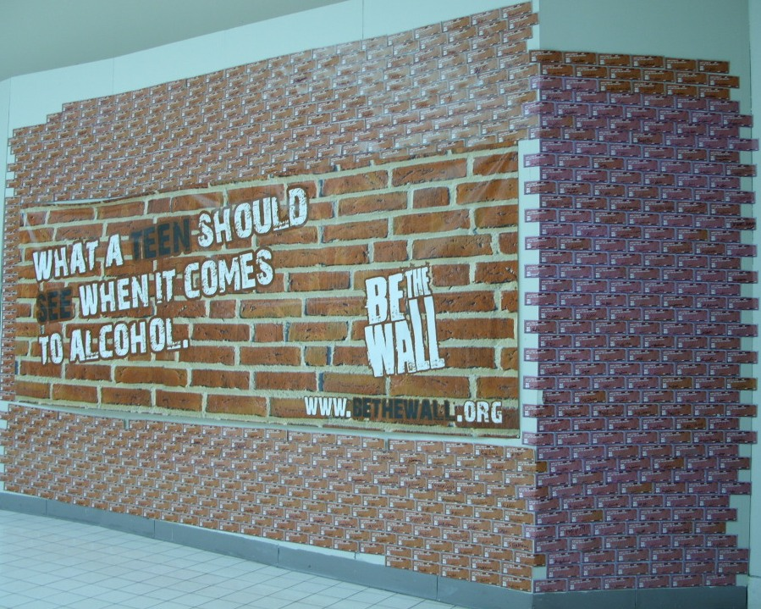

Slide 25
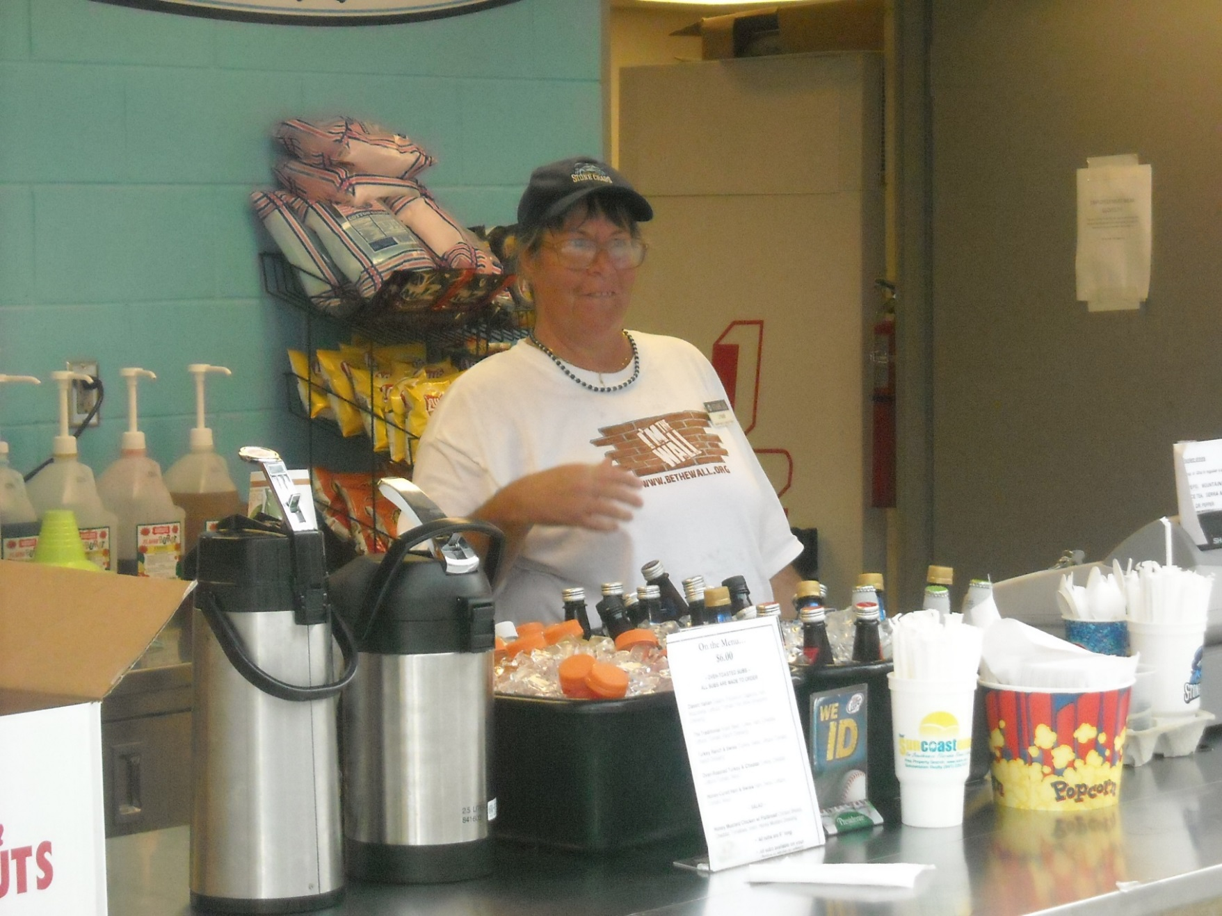

Slide 26
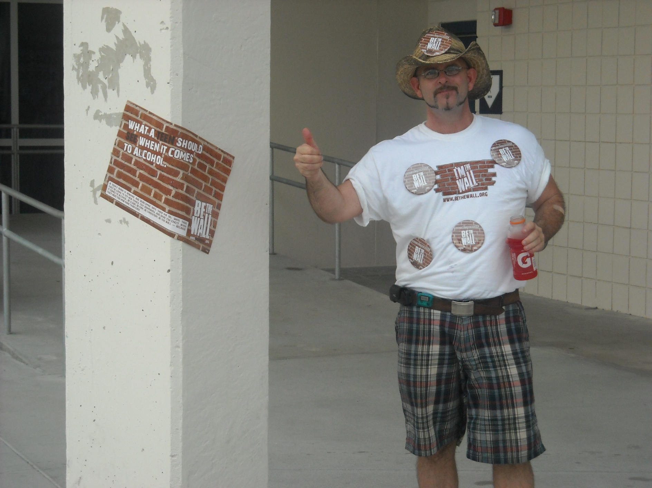

Slide 27
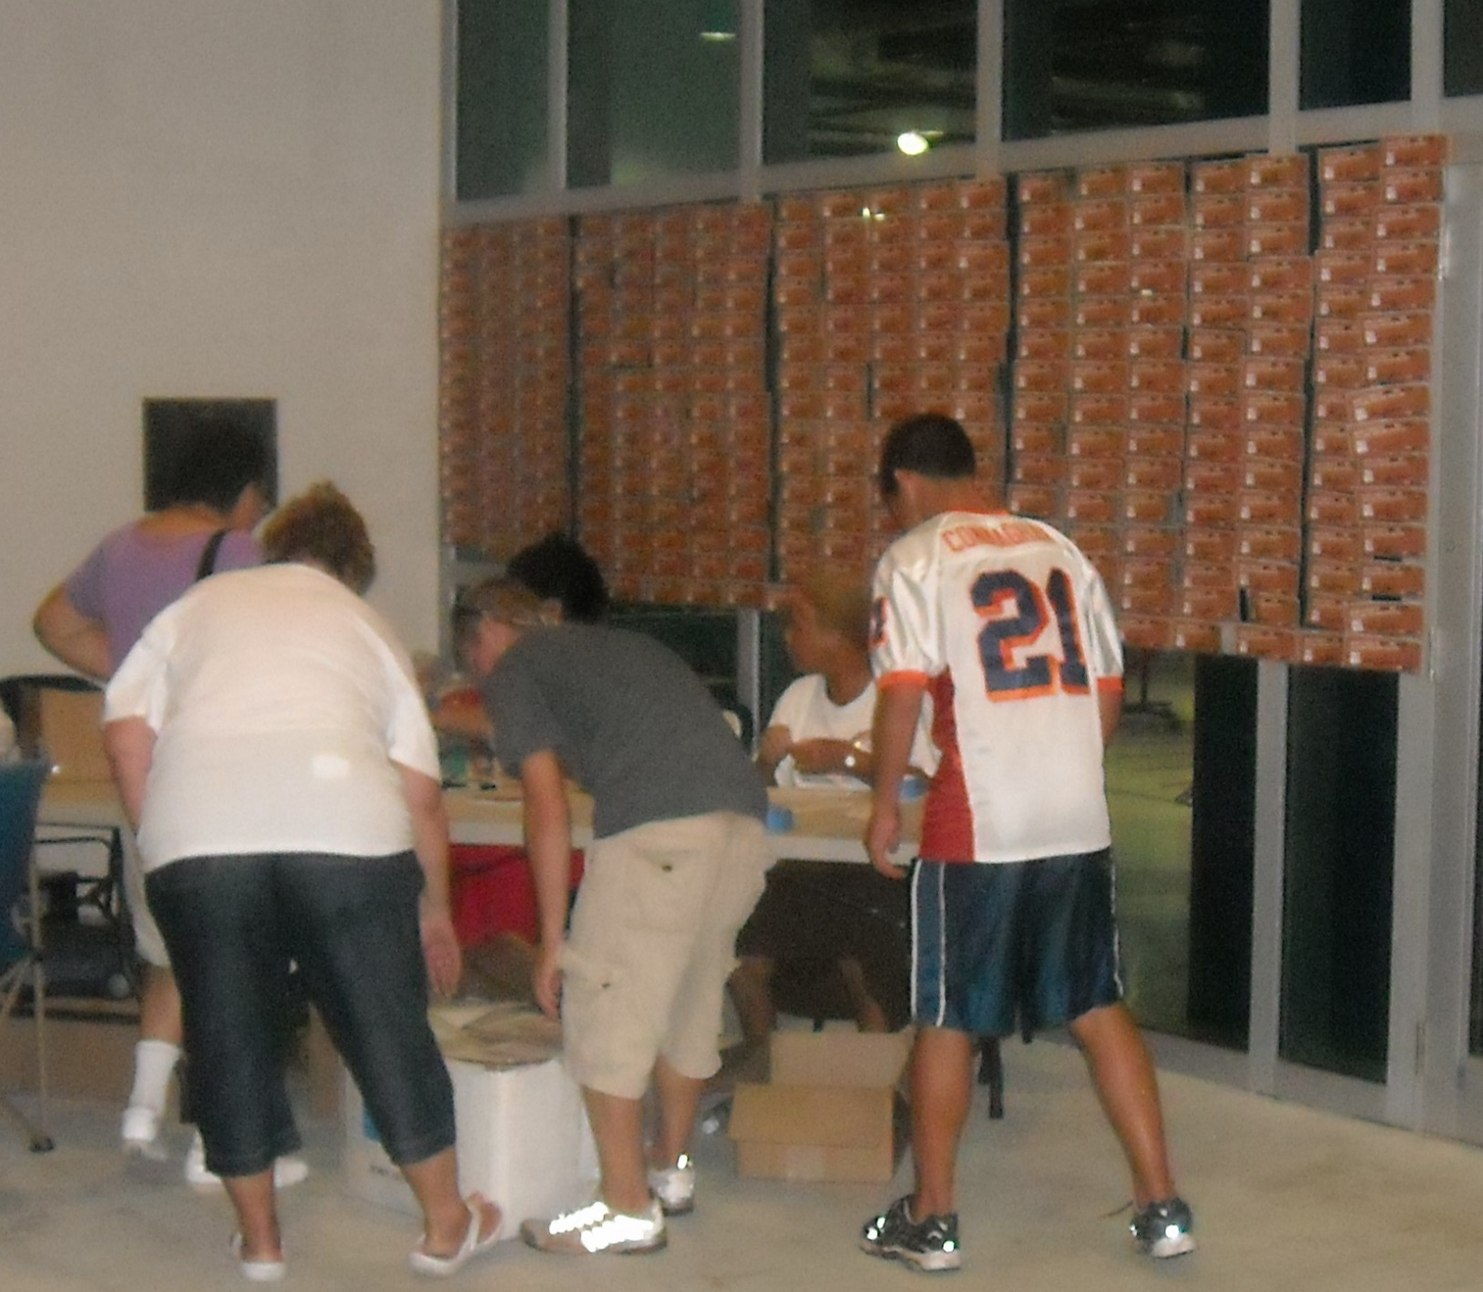

Slide 28
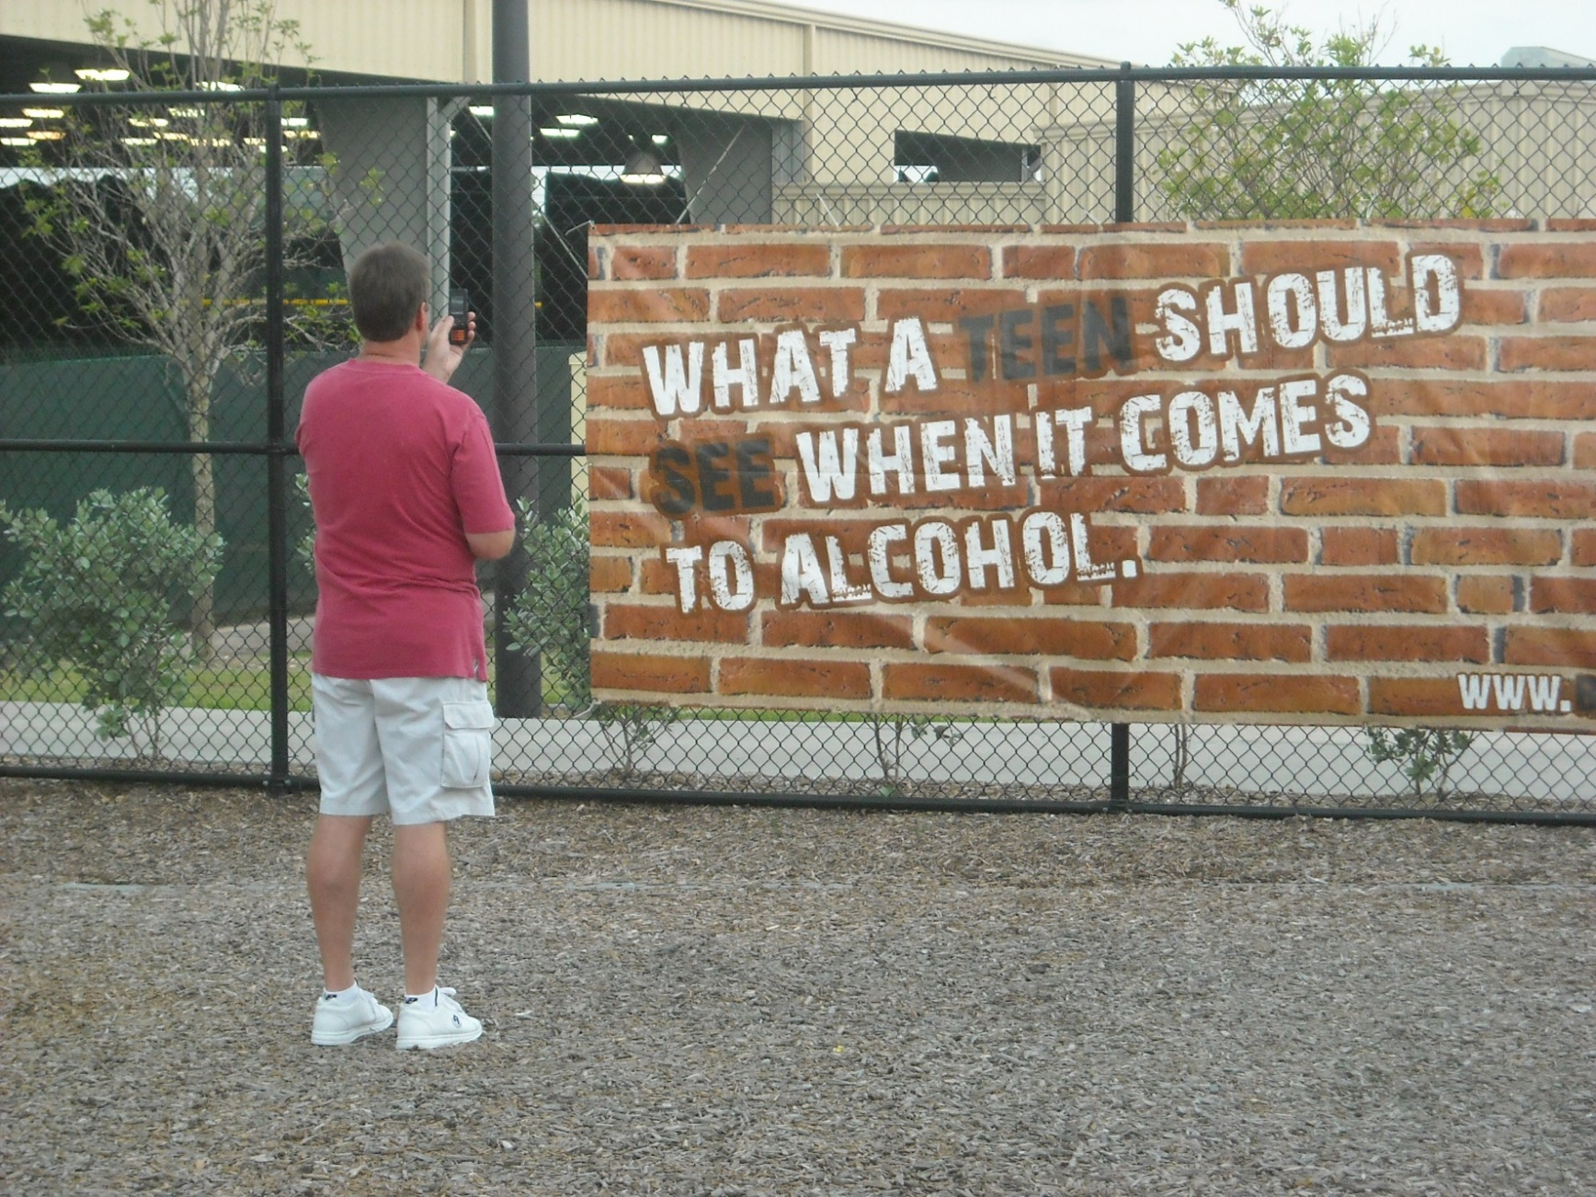

Slide 29
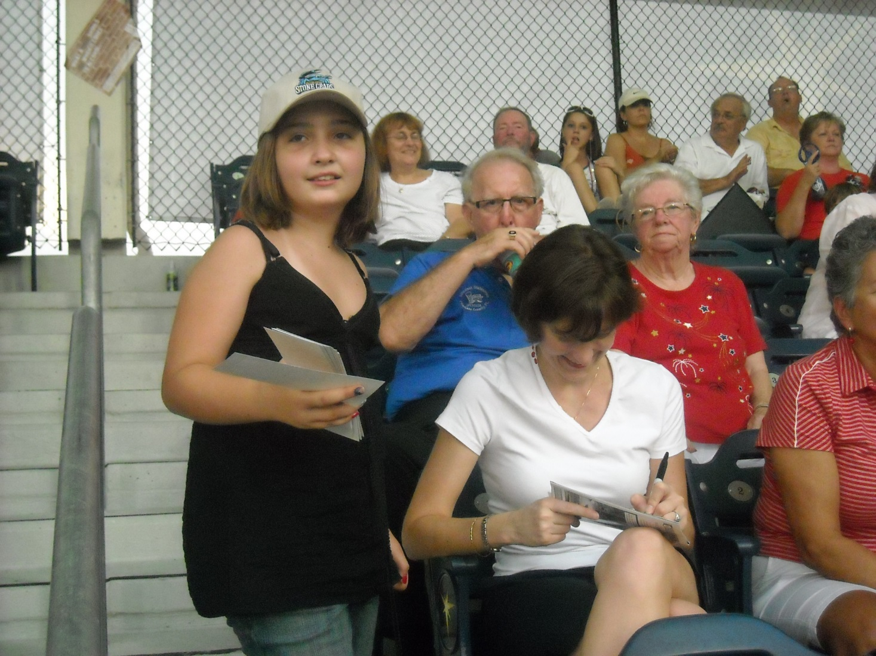

Slide 30
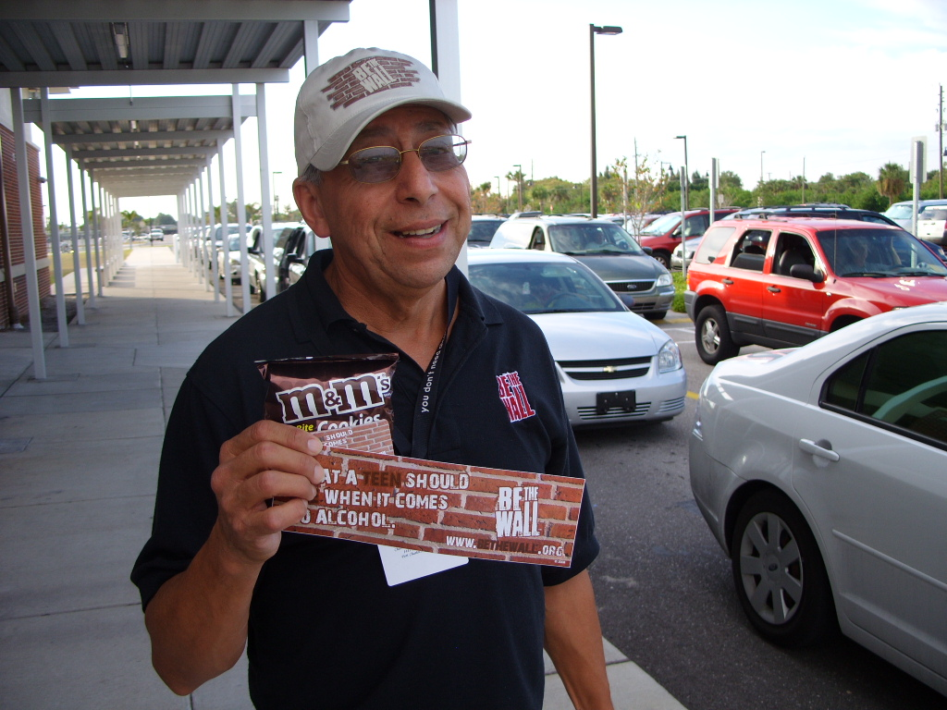

Slide 31
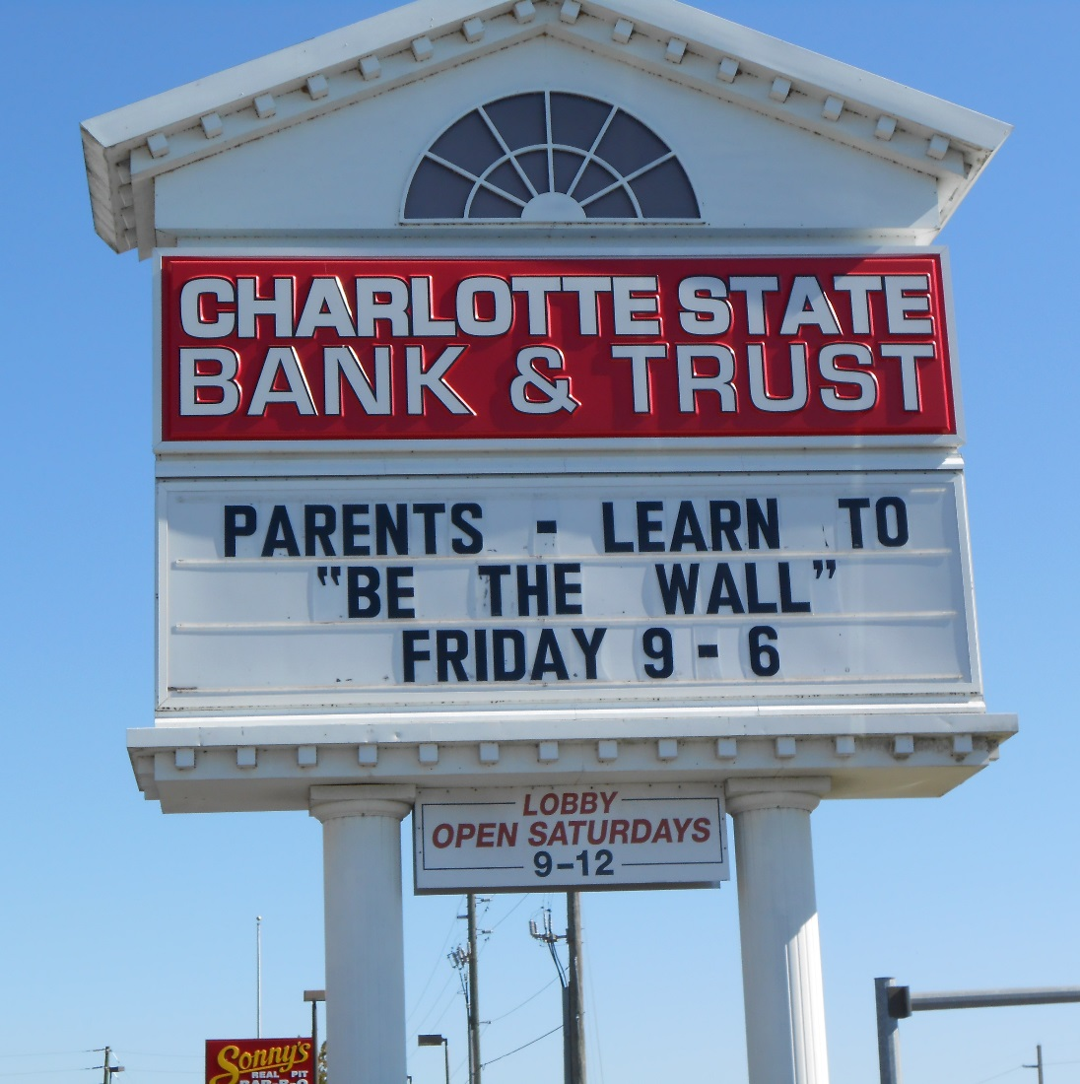
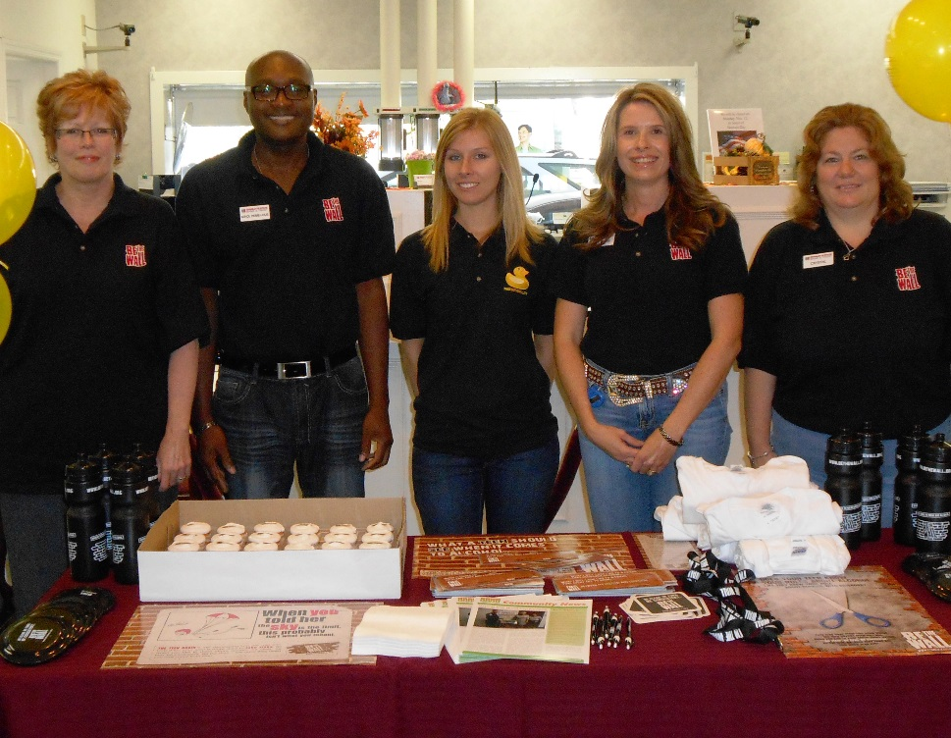

Slide 32
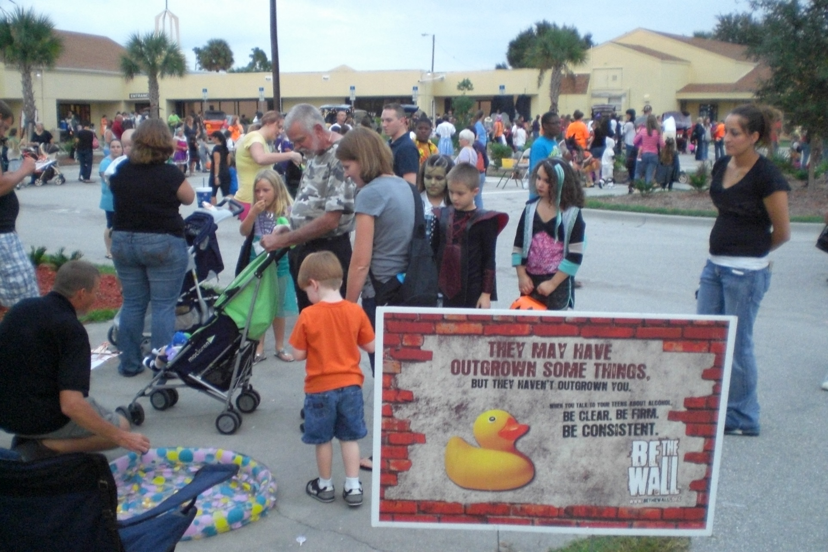

Slide 33
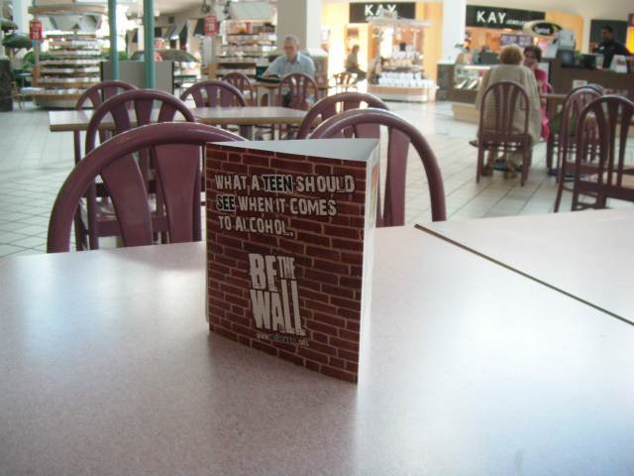

Slide 34
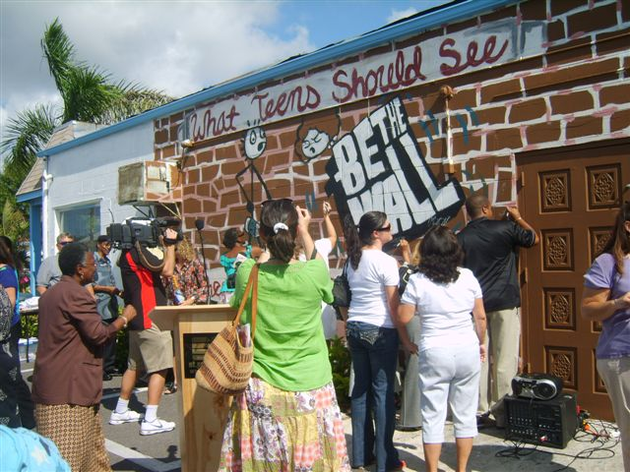

Slide 35
Part 3. What Be The Wall Campaign offers you. . .
Interactive Website
Materials
Tools
Training and Help

Slide 36
www.bethewall.org

Slide 37

www.bethewall.org

Slide 38
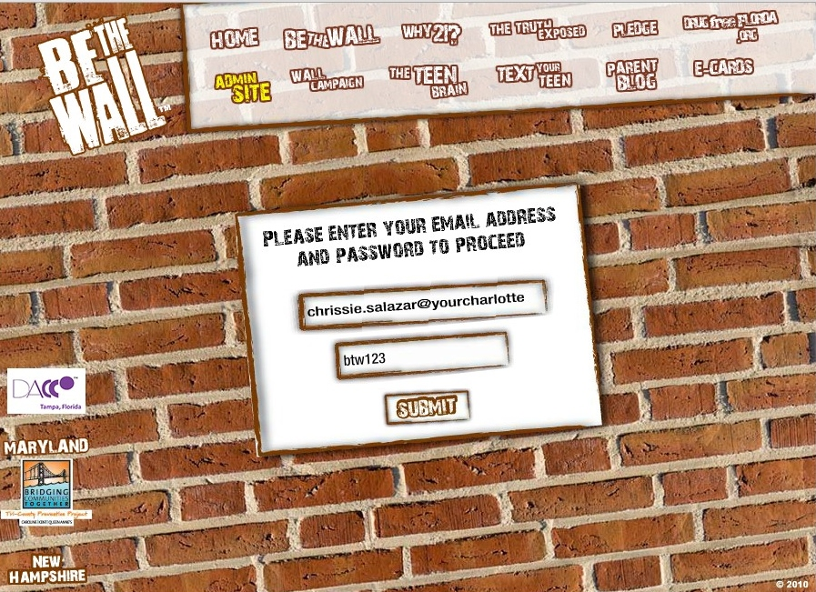
Admin Login

Slide 39
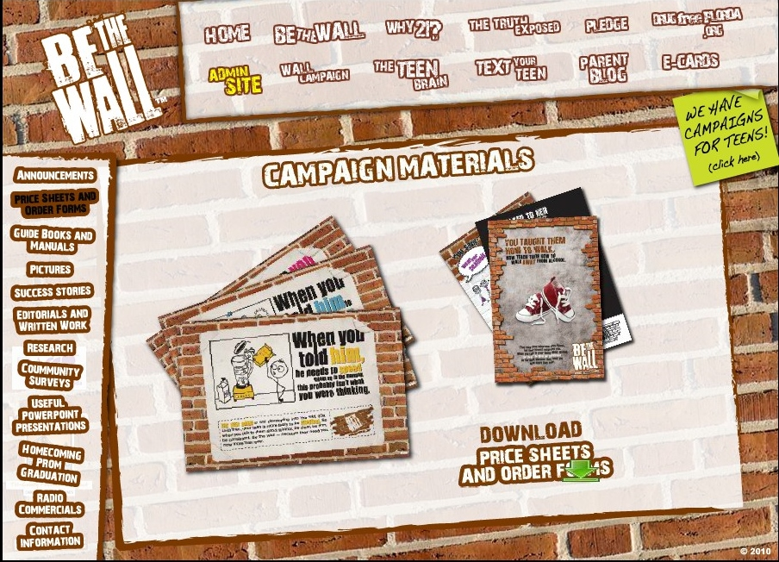
Campaign Materials and Price Sheets

Slide 40


Slide 41



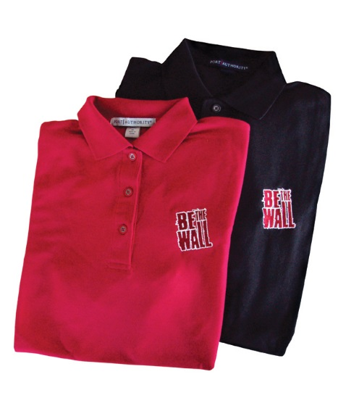
Be The Wall Tools – Phase 1
These represent a small assortment of Phase 1 Be the Wall items. See the complete line at: www.bethewall.org Go to Admin Tab, Enter your Email; Password: btw123

Slide 42
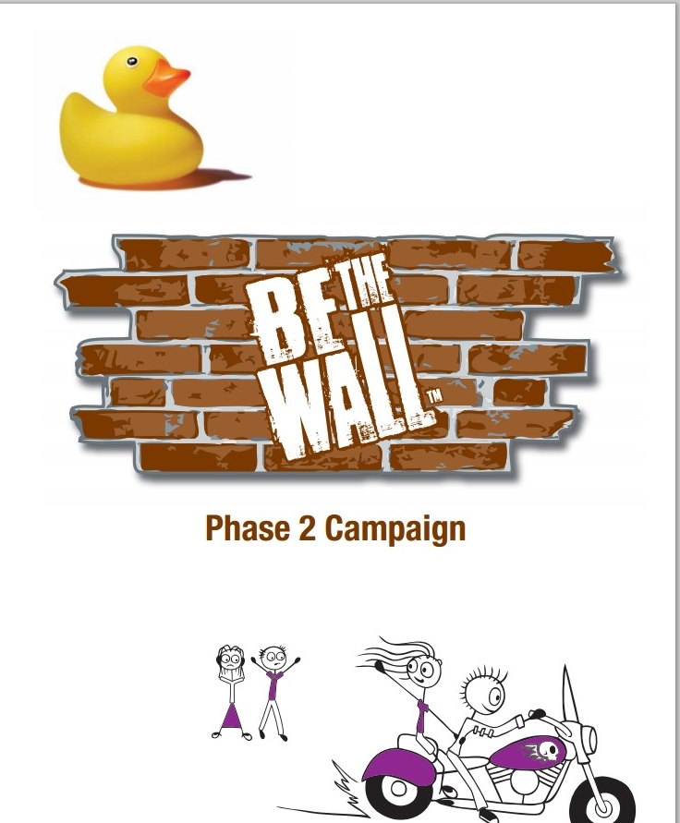

Slide 43








Be The Wall – Phase 2

Slide 44


Slide 45
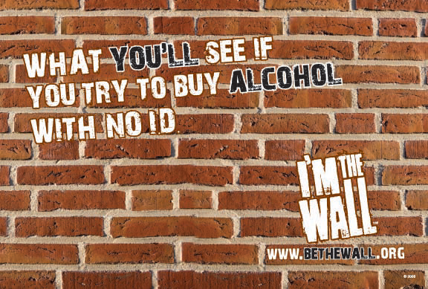

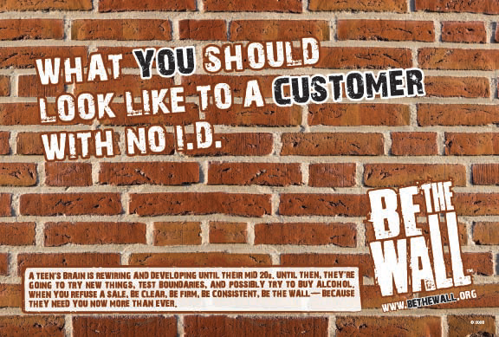
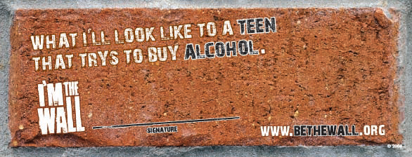



Slide 46
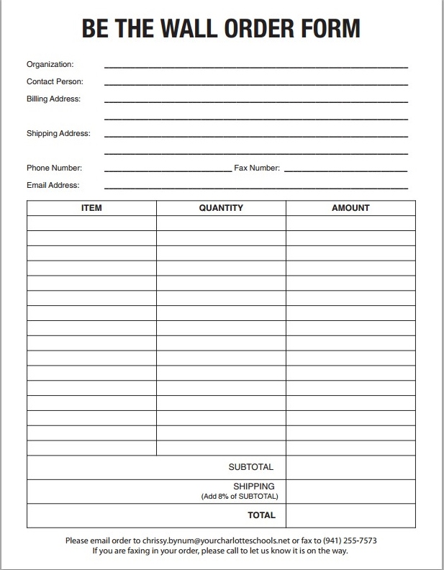

Slide 47
Be The Wall –
Materials and Website

Slide 48
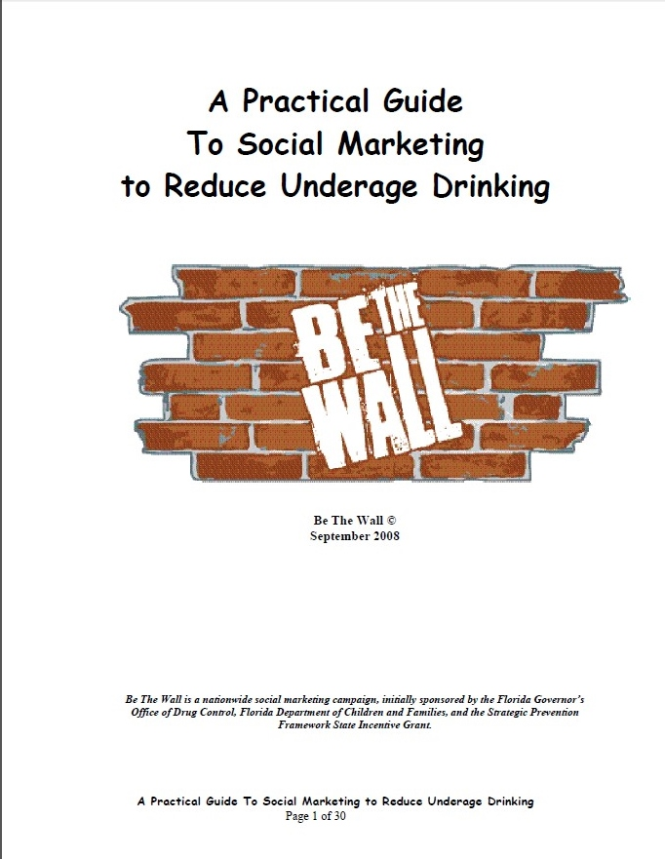

Slide 49
Be the Wall Training
Customized Training – designed to fit the needs of your community
Free to our clients:
  Conference Calls
  Webinars
  Written materials
On-Site visits
  In-House training for your group
    Length of time – to be determined
    Be The Wall (DFCC) staff time and travel to be reimbursed

Slide 50
Your Questions:
1. In your practical guide you say that we need to work with a Social Marketing Coach. Do we need to hire one or do you provide this service?
2. What is the estimated time to implement each phase of the campaign?
Can you provide us an example of the timeframe?
Can you share how was your experience working with other communities like Latinos?
Have you used this strategy with two or more communities or in two or more languages at the same time?
3. If we need or want to use our own message and adapt it to the campaign, what would be the process or model that we need to follow to develop the message?

Slide 51

‘Tweaking’ the message. . .

Slide 52
Any questions?
Thank you so much for your participation in this session. We appreciate you and wish you tremendous success with your Be The Wall campaign.
Chrissy Bynum, Contracts Manager
Chrissy.Bynum@yourcharlotteschools.net
941-979-2760
Chrissie Salazar, Public Outreach Coordinator
Chrissie.Salazar@yourcharlotteschools.net
941-979-7471

